Slide 1
Virtual experiments
Mads Bertelsen, ESS DMSC
Kim Lefmann, University of Copenhagen

Slide 2
Overview of Simulation packages
General-purpose
Standard tools of the trade
McStas
VITESS
RESTRAX – back tracking
MCViNE – uses some McStas
Older packages MSCAT / NISP / IDEAS
General-purpose
Standard tools of the trade
General-purpose
Standard tools of the trade
General-purpose
Standard tools of the trade

Slide 3
Citation analysis
Package use assessed from citations to package papers
Excludes papers on: Software tools Components Optics
176 papers in analysis
Concept, design and optimization: 49%
Instrument paper: 19%
Virtual experiments: 32%

Slide 4
Concepts and design – SELENE on Amor
Experiment
Amor @ PSI, 100 nm Ni film measurement
Misaligned simulation
Perfect simulation
J. Stahn, U. Filges and T. Panzner.
Eur. Phys. J. Appl. Phys. (2012) 58: 11001

Slide 5
Concepts and design – DREAM ESS Instrument design
Instrument accepted for construction
Design presented in paper using VITESS
W Schweika, N Violini, K Lieutenant, C Zendler, D Nekrassov, A Houben, P Jacobs and P F Henry
2016 J. Phys.: Conf. Ser. 746 012013

Slide 6
Concepts and design – DREAM ESS Instrument design
DREAM
POWGEN
Comparison to existing instrumentation
View of 2D data collection
WISH
Na₂Ca₃Al₂F₁₄
W Schweika, N Violini, K Lieutenant, C Zendler, D Nekrassov, A Houben, P Jacobs and P F Henry
2016 J. Phys.: Conf. Ser. 746 012013

Slide 7
Global optimization – Generic ESS instrument suite
Simulation of straw-man instrument suite for range of pulse time structures
Kim Lefmann, Kaspar H. Klenø, Jonas Okkels Birk, Britt R. Hansen, Sonja L. Holm, Erik Knudsen, Klaus Lieutenant, Lars von Moos, Morten Sales,
Peter K. Willendrup, and Ken H. Andersen. Review of Scientific Instruments 84, 055106 (2013); doi: 10.1063/1.4803167

Slide 8
Global optimization – Generic ESS instrument suite
Example: IN5-like cold chopper spectrometer
Kim Lefmann, Kaspar H. Klenø, Jonas Okkels Birk, Britt R. Hansen, Sonja L. Holm, Erik Knudsen, Klaus Lieutenant, Lars von Moos, Morten Sales,
Peter K. Willendrup, and Ken H. Andersen. Review of Scientific Instruments 84, 055106 (2013); doi: 10.1063/1.4803167

Slide 9
Global optimization – Generic ESS instrument suite
Example: IN5-like cold chopper spectrometer
Moderator origin of rays
Kim Lefmann, Kaspar H. Klenø, Jonas Okkels Birk, Britt R. Hansen, Sonja L. Holm, Erik Knudsen, Klaus Lieutenant, Lars von Moos, Morten Sales,
Peter K. Willendrup, and Ken H. Andersen. Review of Scientific Instruments 84, 055106 (2013); doi: 10.1063/1.4803167

Slide 10
Global optimization – Generic ESS instrument suite
Kim Lefmann, Kaspar H. Klenø, Jonas Okkels Birk, Britt R. Hansen, Sonja L. Holm, Erik Knudsen, Klaus Lieutenant, Lars von Moos, Morten Sales,
Peter K. Willendrup, and Ken H. Andersen. Review of Scientific Instruments 84, 055106 (2013); doi: 10.1063/1.4803167

Slide 11
Global optimization – ESS Moderator optimization
Brilliance gain from small moderator heights discovered by ESS target group
Need to reconsider moderator
Andersen, K. H., Bertelsen, M., Zanini, L., Klinkby, E. B., Schonfeldt, T.,
Bentley, P. M., & Saroun, J. (2018). Journal of Applied Crystallography, 51, 264-281.

Slide 12
Global optimization – ESS Moderator optimization
Brilliance gain from small moderator heights discovered by ESS target group
Need to reconsider moderator
Guide optimization for range of moderator heights
Andersen, K. H., Bertelsen, M., Zanini, L., Klinkby, E. B., Schonfeldt, T.,
Bentley, P. M., & Saroun, J. (2018). Journal of Applied Crystallography, 51, 264-281.

Slide 13
Global optimization – ESS Moderator optimization

Slide 14
Global optimization – ESS Moderator optimization
Andersen, K. H., Bertelsen, M., Zanini, L., Klinkby, E. B., Schonfeldt, T.,
Bentley, P. M., & Saroun, J. (2018). Journal of Applied Crystallography, 51, 264-281.

Slide 15
Global optimization – ESS Moderator optimization
Brilliance gain from small moderator heights discovered by ESS target group
Need to reconsider moderator
Guide optimization for range of moderator heights
Sufficient data for informed decision
Andersen, K. H., Bertelsen, M., Zanini, L., Klinkby, E. B., Schonfeldt, T.,
Bentley, P. M., & Saroun, J. (2018). Journal of Applied Crystallography, 51, 264-281.

Slide 16
Instrument papers – 4SEASONS @ J-PARC
Resolution as expected in commissioning of 4SEASONS
65% of simulated intensity
Ryoichi Kajimoto, Mitsutaka Nakamura, Yasuhiro Inamura, Fumio Mizuno, Kenji Nakajima, Seiko Ohira-Kawamura, Tetsuya Yokoo, Takeshi Nakatani,
Ryuji Maruyama, Kazuhiko Soyama, Kaoru Shibata, Kentaro Suzuya, Setsuo Sato, Kazuya Aizawa, Masatoshi Arai, Shuichi Wakimoto, Motoyuki Ishikado,
Shin-ichi Shamoto, Masaki Fujita, Haruhiro Hiraka, Kenji Ohoyama, Kazuyoshi Yamada, and Chul-Ho Lee. J. Phys. Soc. Jpn. 80 (2011) SB025

Slide 17
Instrument papers – SEQUOIA @ SNS
SEQUOIA Instrument paper
Needed to adjust for: Al windows Air in beam Monitor energy response Electronic response time
No arbitrary scaling factor
G. E. Granroth, A. I. Kolesnikov, T. E. Sherline, J. P. Clancy, K. A. Ross, J. P. C. Ruff, B. D. Gaulin, S. E. Nagler
2010 J. Phys.: Conf. Ser. 251 012058

Slide 18
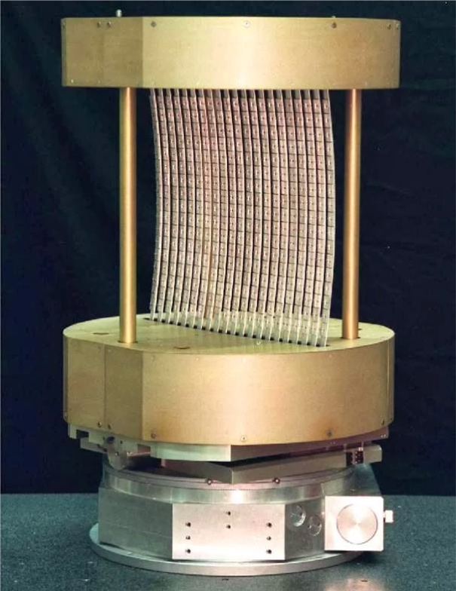
Instrument papers – MACS @ NIST
MACS Monochromator characterization
From NIST webpage
J A Rodriguez , D M Adler, P C Brand, C Broholm, J C Cook, C Brocker, R Hammond, Z Huang, P Hundertmark, J W Lynn,
N C Maliszewskyj, J Moyer, J Orndorff, D Pierce, T D Pike, G Scharfstein, S A Smee and R Vilaseca. 2008 Meas. Sci. Technol. 19 034023

Slide 19
Instrument papers – MACS @ NIST
Experiment
Simulation
MACS Monochromator characterization
L₀(2ϴ=90) scans
J A Rodriguez , D M Adler, P C Brand, C Broholm, J C Cook, C Brocker, R Hammond, Z Huang, P Hundertmark, J W Lynn,
N C Maliszewskyj, J Moyer, J Orndorff, D Pierce, T D Pike, G Scharfstein, S A Smee and R Vilaseca. 2008 Meas. Sci. Technol. 19 034023

Slide 20
Instrument papers – MACS @ NIST
Experiment
Simulation
MACS Monochromator characterization
d₁ scans
J A Rodriguez , D M Adler, P C Brand, C Broholm, J C Cook, C Brocker, R Hammond, Z Huang, P Hundertmark, J W Lynn,
N C Maliszewskyj, J Moyer, J Orndorff, D Pierce, T D Pike, G Scharfstein, S A Smee and R Vilaseca. 2008 Meas. Sci. Technol. 19 034023

Slide 21
Virtual experiment benchmarks – RITAII @ PSI
Triple axis spectrometer with 7 analyzer blades
Vanadium sample
L. Udby, P.K. Willendrup, E. Knudsen, Ch. Niedermayer, U. Filges, N.B. Christensen, E. Farhi, B.O. Wells, K. Lefmann.
Nuclear Instruments and Methods in Physics Research A 634 (2011) S138–S143

Slide 22
Virtual experiment benchmarks – RITAII @ PSI
Triple axis spectrometer with 7 analyzer blades
Here measurement with center blade
Al₂O₃ powder sample
L. Udby, P.K. Willendrup, E. Knudsen, Ch. Niedermayer, U. Filges, N.B. Christensen, E. Farhi, B.O. Wells, K. Lefmann.
Nuclear Instruments and Methods in Physics Research A 634 (2011) S138–S143

Slide 23
Virtual experiment benchmarks – Prismatic analyzer
Prismatic analyzer concept discovered under CAMEA / BIFROST development
Jonas O. Birk, Márton Markó, Paul G. Freeman, Johan Jacobsen, Rasmus L. Hansen, Niels B. Christensen, Christof Niedermayer, Martin Månsson,
Henrik M. Rønnow, and Kim Lefmann. Review of Scientific Instruments 85, 113908 (2014); doi: 10.1063/1.4901160

Slide 24
Virtual experiment benchmarks – Prismatic analyzer
Prismatic analyzer concept discovered under CAMEA / BIFROST development
Simulations show it should work
Jonas O. Birk, Márton Markó, Paul G. Freeman, Johan Jacobsen, Rasmus L. Hansen, Niels B. Christensen, Christof Niedermayer, Martin Månsson,
Henrik M. Rønnow, and Kim Lefmann. Review of Scientific Instruments 85, 113908 (2014); doi: 10.1063/1.4901160

Slide 25
Virtual experiment benchmarks – Prismatic analyzer
Prismatic analyzer concept discovered under CAMEA / BIFROST development
Simulations show it should work
Measured on CAMEA prototype at PSI
Jonas O. Birk, Márton Markó, Paul G. Freeman, Johan Jacobsen, Rasmus L. Hansen, Niels B. Christensen, Christof Niedermayer, Martin Månsson,
Henrik M. Rønnow, and Kim Lefmann. Review of Scientific Instruments 85, 113908 (2014); doi: 10.1063/1.4901160

Slide 26
Virtual experiment – Resolution convolution on IN8 @ ILL
Dirac Metals
Resolution convolution of fit with RESTRAX results
M. C. Rahn, A. J. Princep, A. Piovano, J. Kulda, Y. F. Guo, Y. G. Shi, and A. T. Boothroyd
Phys. Rev. B 95, 134405 – Published 4 April 2017

Slide 27
Virtual experiment – Resolution convolution on IN8 @ ILL
Dirac Metals
Convoluted model compared with data
M. C. Rahn, A. J. Princep, A. Piovano, J. Kulda, Y. F. Guo, Y. G. Shi, and A. T. Boothroyd
Phys. Rev. B 95, 134405 – Published 4 April 2017

Slide 28
Virtual experiment – Uranium Nitride on ARCS and SEQUIOA @ SNS
Uranium Nitride (MCViNE)
Single / Multiple scattering
Experiment
Simulated
Single scattering
Simulated
All scattering orders
J. Y. Y. Lin, A. A. Aczel, D. L. Abernathy, S. E. Nagler, W. J. L. Buyers, and G. E. Granroth
Phys. Rev. B 89, 144302 – Published 7 April 2014

Slide 29
Virtual experiment – Uranium Nitride on ARCS and SEQUIOA @ SNS
Uranium Nitride (MCViNE)
Single / Multiple scattering
J. Y. Y. Lin, A. A. Aczel, D. L. Abernathy, S. E. Nagler, W. J. L. Buyers, and G. E. Granroth
Phys. Rev. B 89, 144302 – Published 7 April 2014

Slide 30
Virtual experiment – Uranium Nitride on ARCS and SEQUIOA @ SNS
Uranium Nitride (MCViNE)
Single / Multiple scattering
J. Y. Y. Lin, A. A. Aczel, D. L. Abernathy, S. E. Nagler, W. J. L. Buyers, and G. E. Granroth
Phys. Rev. B 89, 144302 – Published 7 April 2014

Slide 31
Virtual experiment – Uranium Nitride on ARCS and SEQUIOA @ SNS
Uranium Nitride (MCViNE)
Single / Multiple scattering
Temperature broadening
J. Y. Y. Lin, A. A. Aczel, D. L. Abernathy, S. E. Nagler, W. J. L. Buyers, and G. E. Granroth
Phys. Rev. B 89, 144302 – Published 7 April 2014

Slide 32
Summary
These packages are trusted
Here we saw use in, Facility level decisions Instrument design Benchmark for instrument test Data analysis
In addition to heavy use in optics
Standard tool of the trade
Expected continued growth
Recent developments will encourage use in new areas

Slide 33
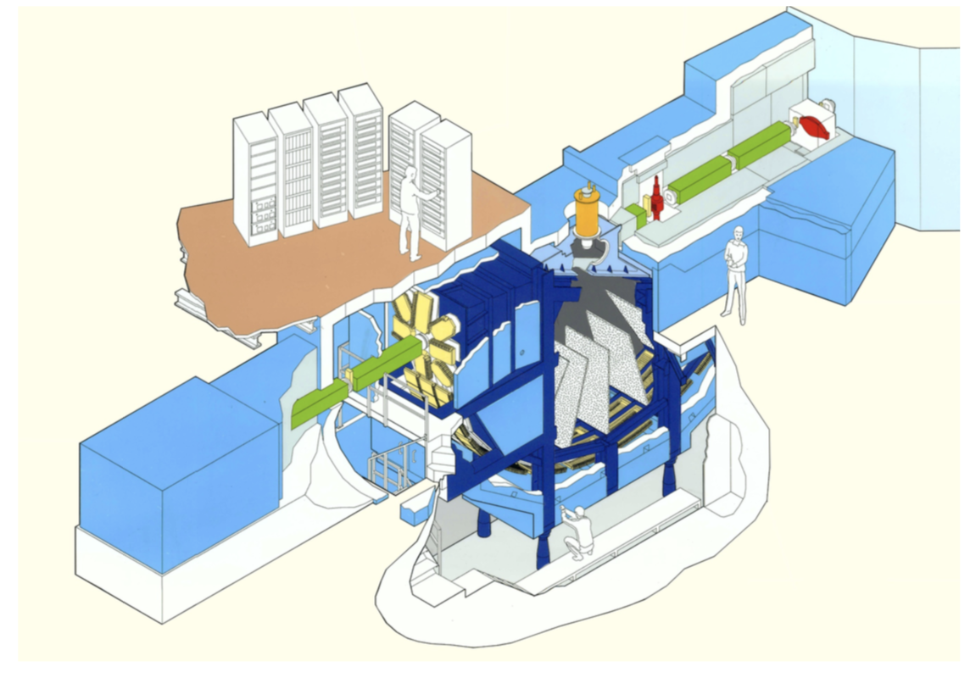
My work on MARI @ ISIS
Simulation of instrument and comparison to data
Experiment performed by John Taylor and members from Kim Kefmanns group
Time of flight data
Powder spectrometer

Slide 34
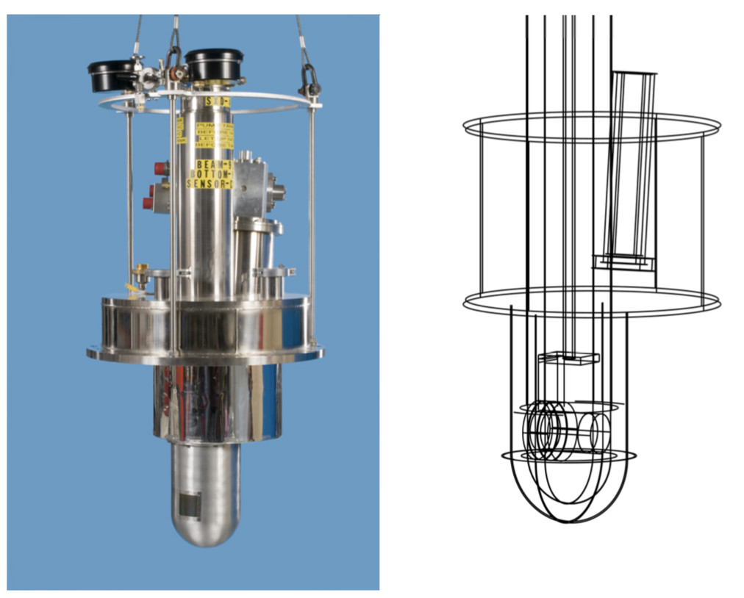
Sample environment
Detectors underneath sample environment
Only lower part simulated

Slide 35
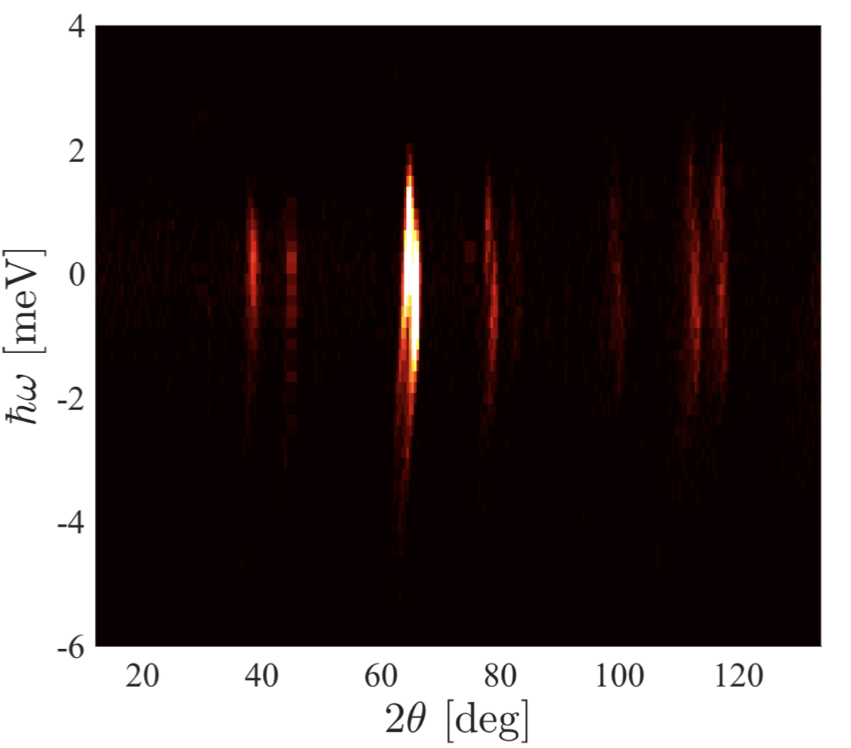
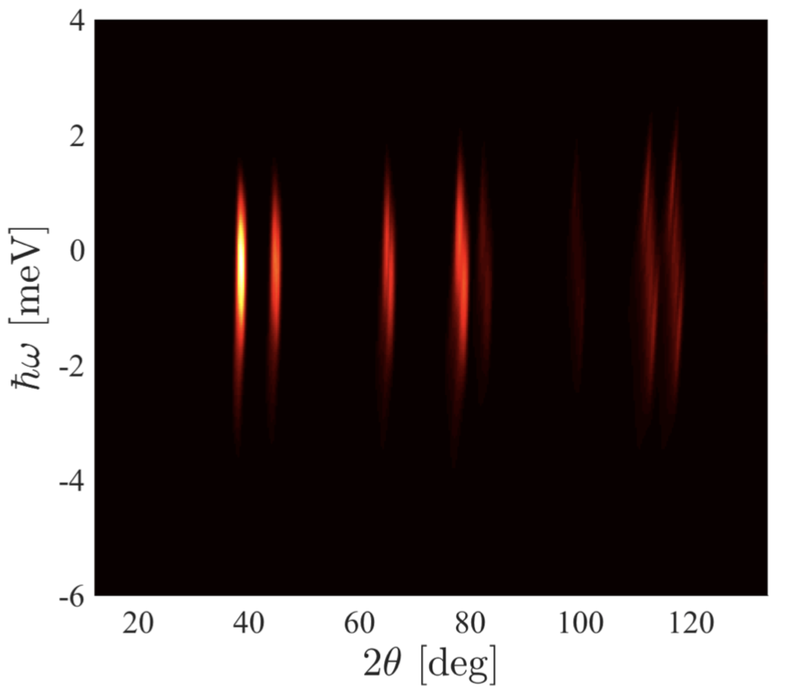
Empty sample environment 35 meV beam
Measurement
Simulation

Slide 36
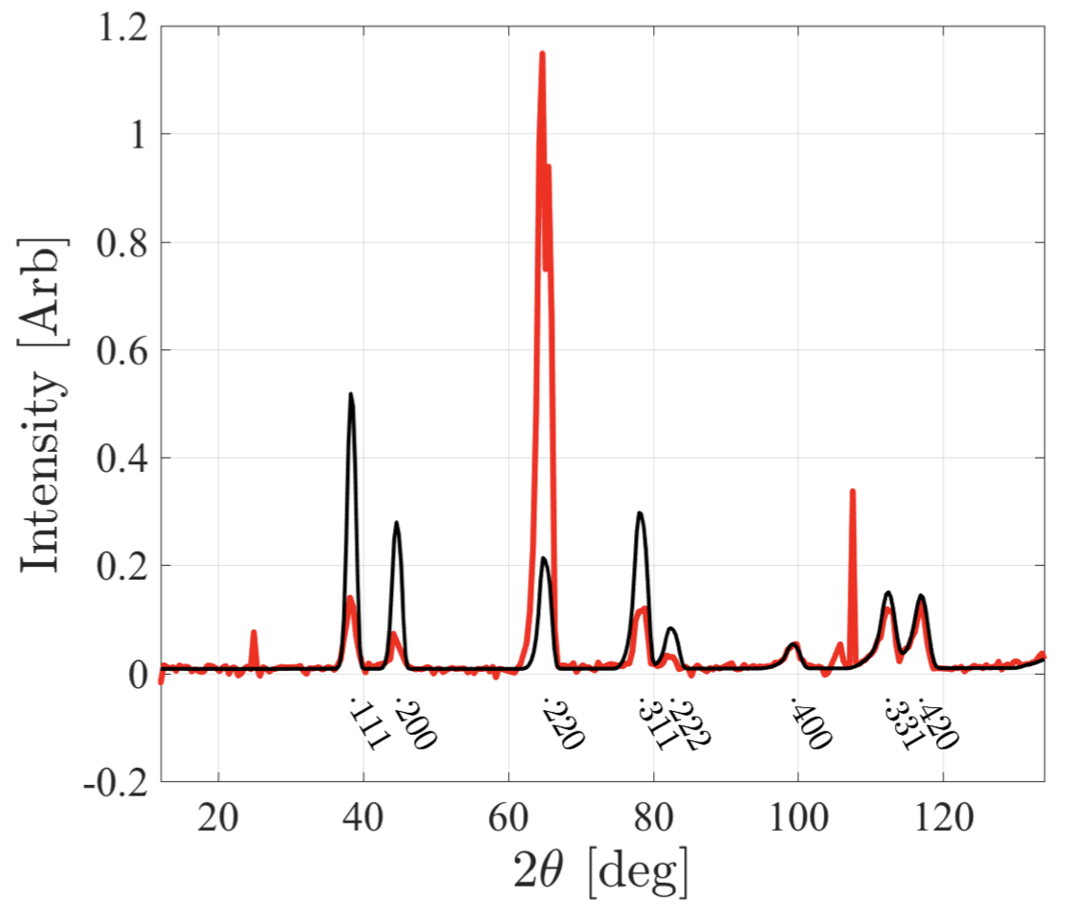
Empty sample environment 35 meV beam
Some issue with texture in cryostat, preferred orientations in the powder

Slide 37
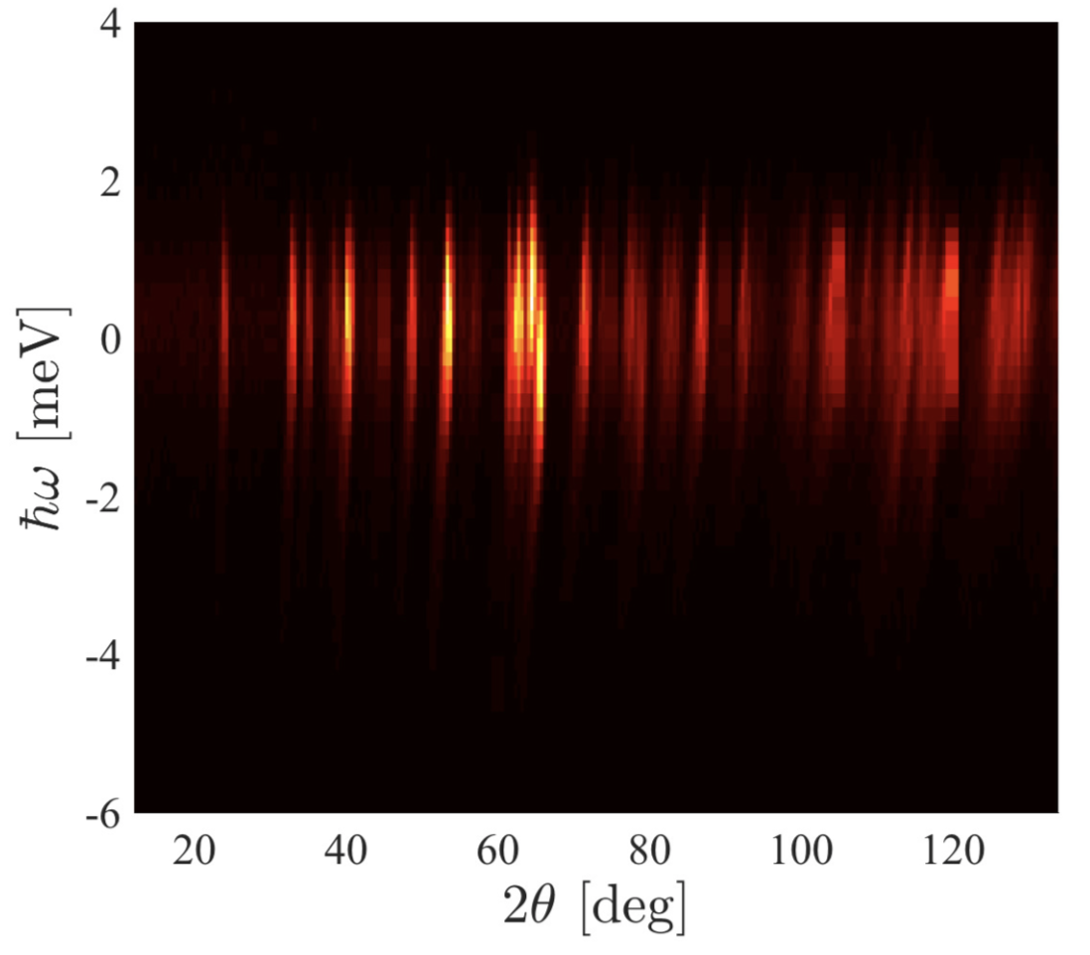
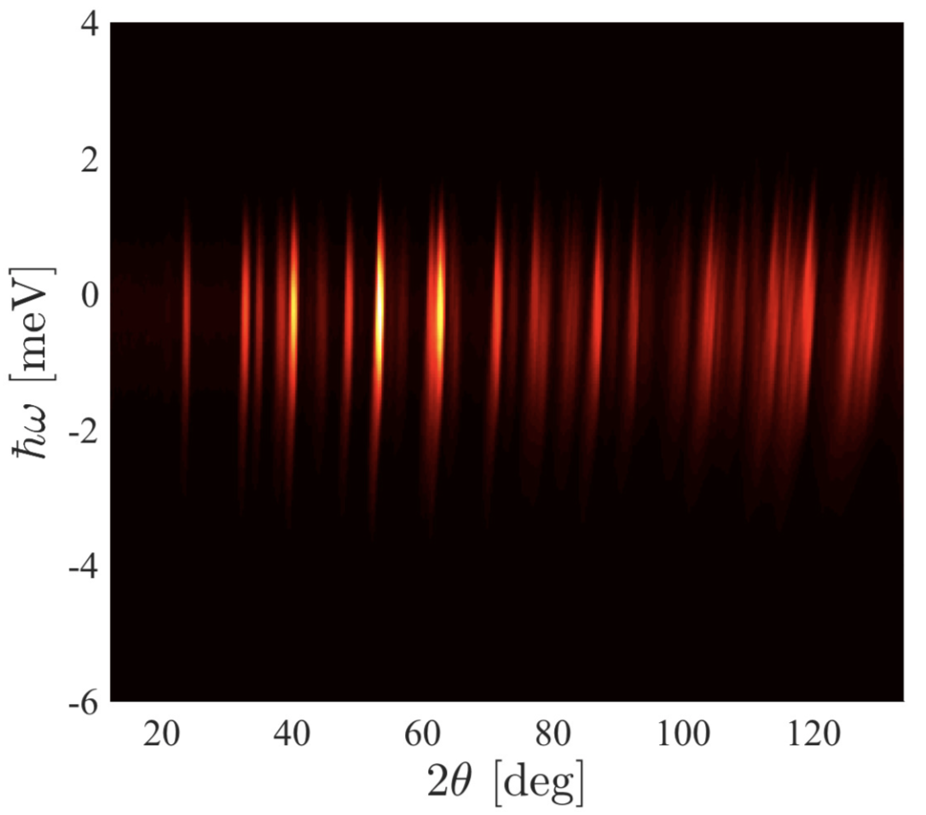
With sample 35 meV
Measurement
Simulation

Slide 38
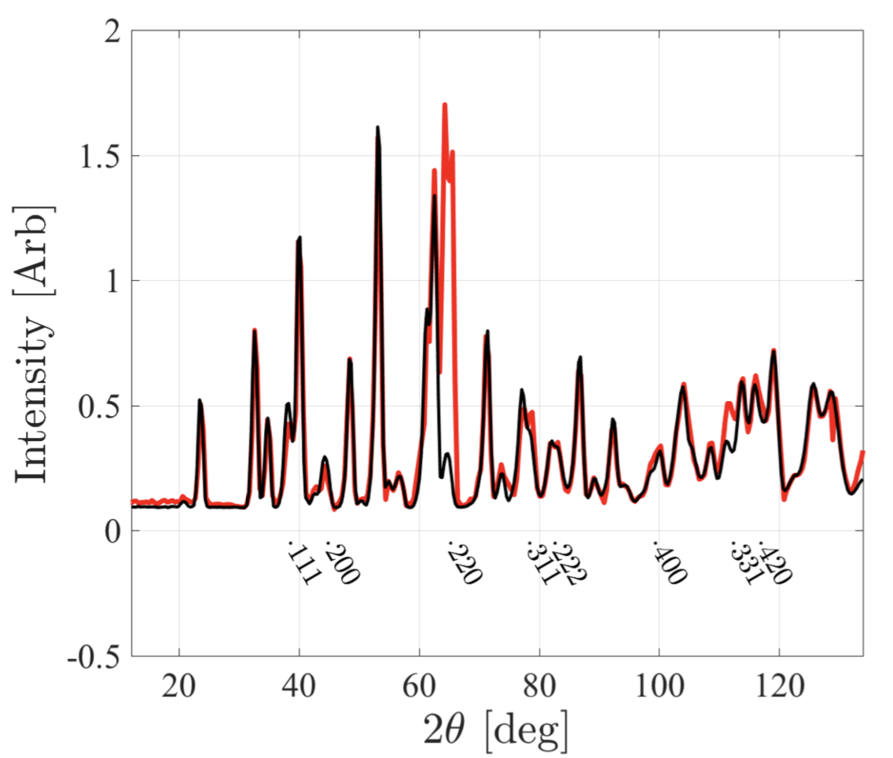
With sample 35 meV
Sample signal matches well
Still issue from the empty cryostat

Slide 39
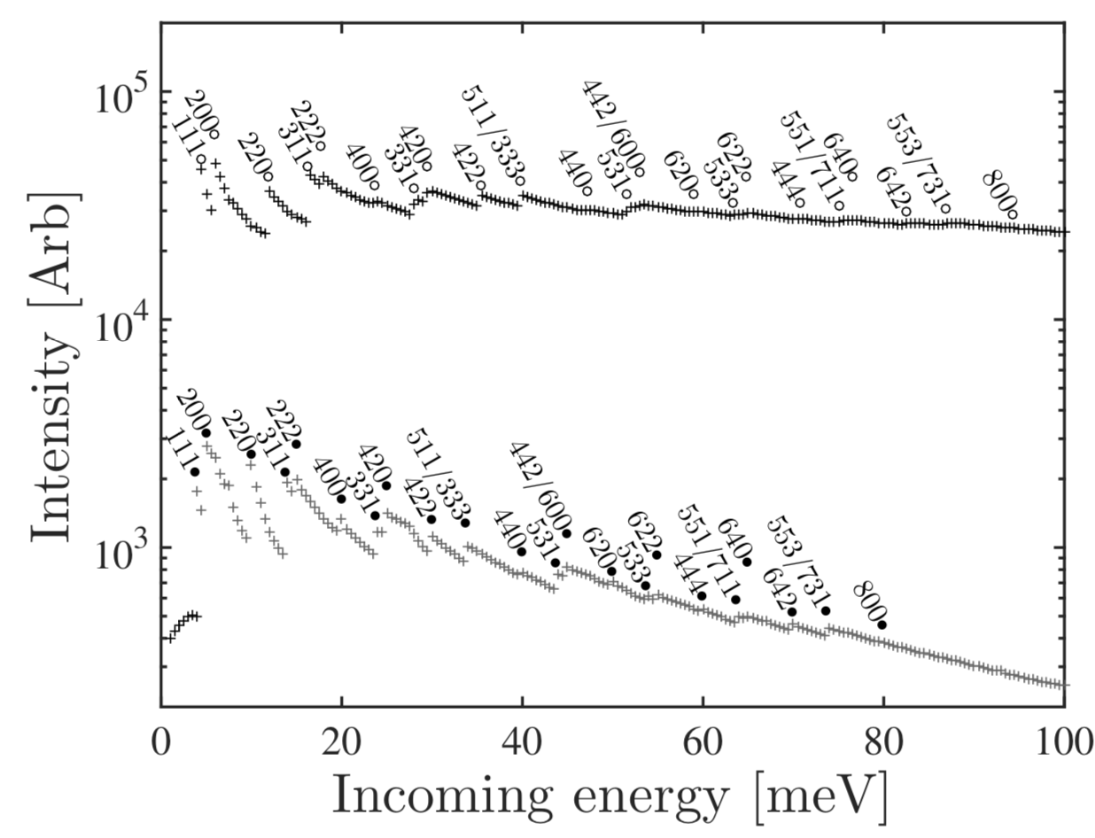
Selecting best incoming energy
Bragg peak is at 2 theta = 134 deg
Bragg peak is at 2 theta = 180 deg
Single scattering measured by instrument depend on detector coverage
Multiple scattering depends on activation of Bragg reflections
Total scattering
Multiple scattering

Slide 40
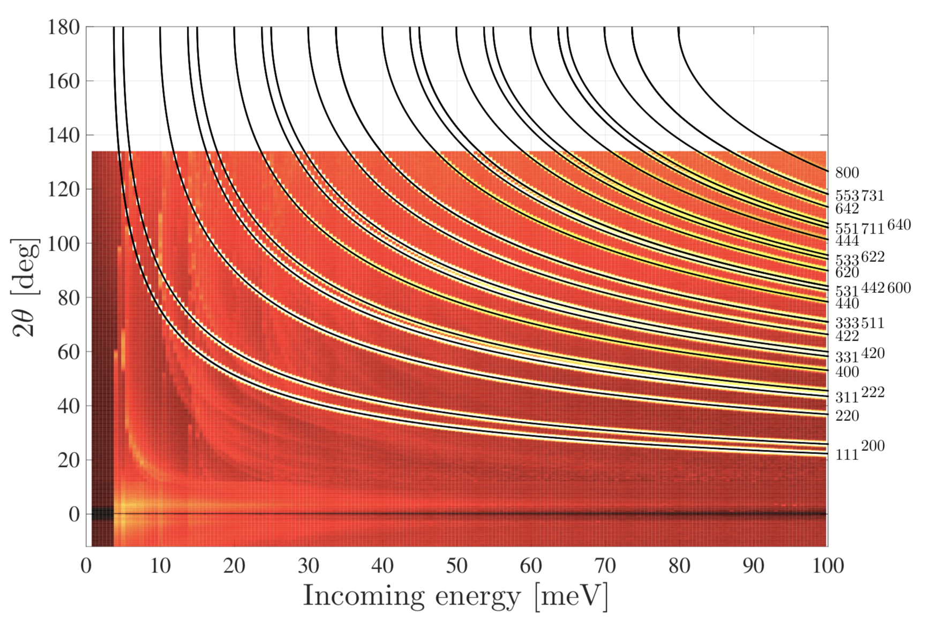
Selecting best incoming energy
Al powder lines

Slide 41
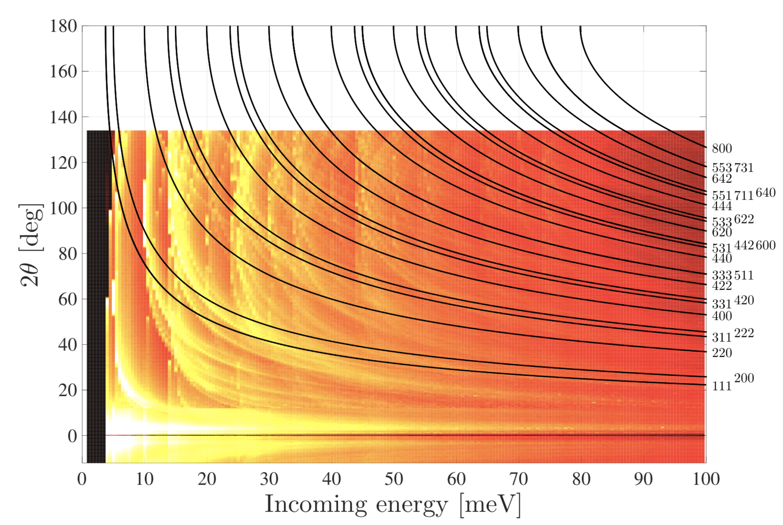
Selecting best incoming energy
Al powder lines
Only multiple scattering

Slide 42
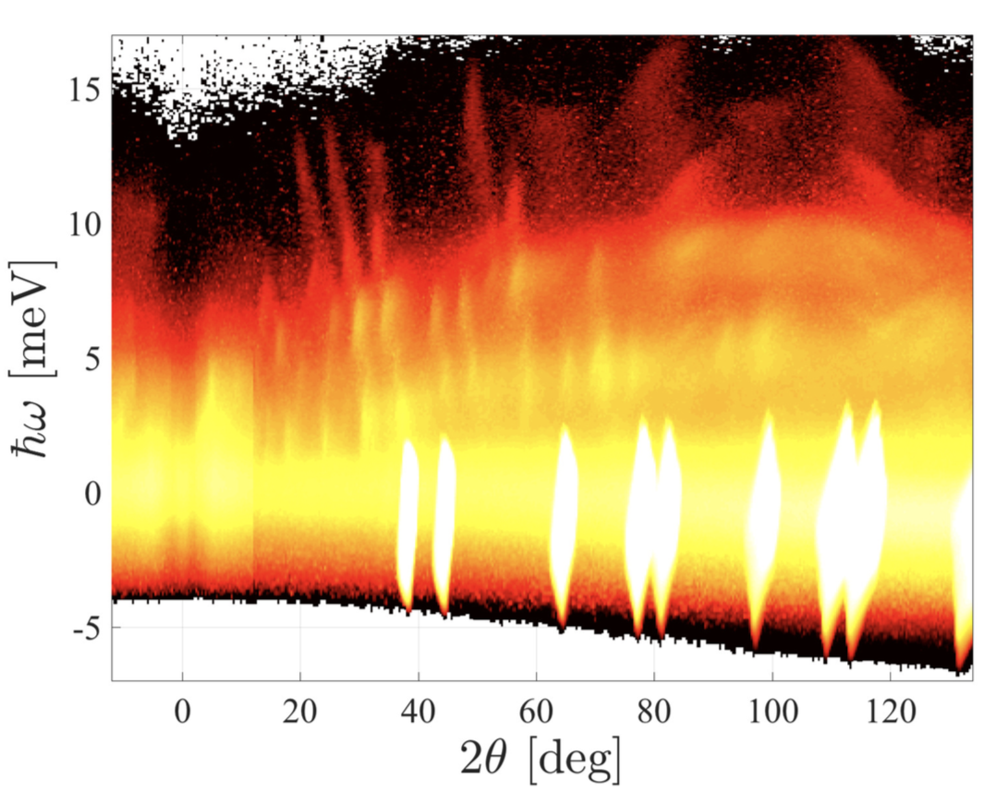
Selecting best incoming energy
Simulation of 35 meV
Logarithmic scale 2 – 7 orders below Al powder bragg peaks

Slide 43
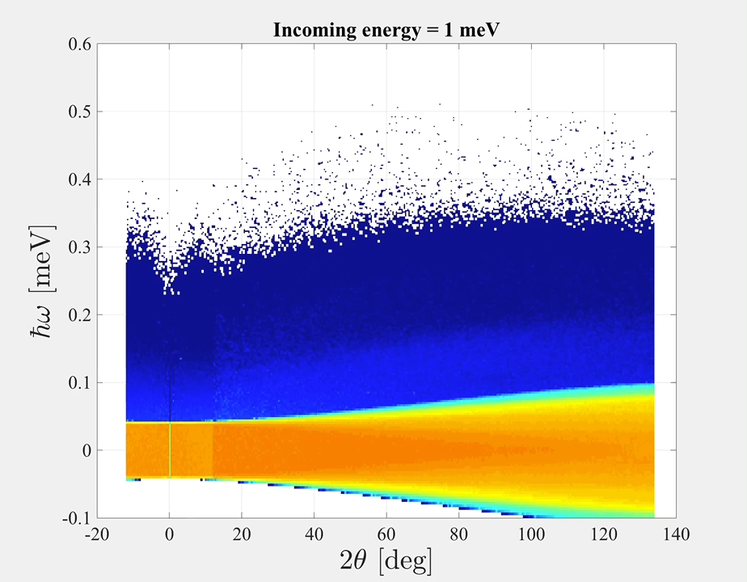
Selecting best incoming energy
Simulation of empty cryostat
Range of incoming energies
Showing resulting dataset

Slide 44
Conclusions
Difficult to simulate all aspects and get perfect agreement
Simulation provides some important benefits when it is accomplished
For example assistance in selecting the best settings for an instrument

